Slide 1

Crafting a Traffic Light System

Slide 2

LIST OF COMPONENTS:
ESP32 MICROCONTROLLER
LED’S(TWO WAY TRAFFIC SYSTEM)
BREAD BOARD
JUMPER WIRES

Slide 3
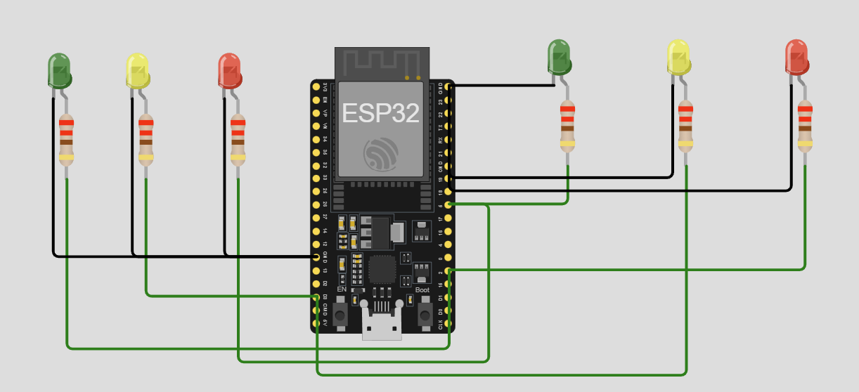
CIRCUIT DIAGRAM
CONNECT GREEN1&RED2-D2
CONNECT YELLOW1&YELLOW2-D3
CONNECT RED1&GREEN2-D5

Slide 4
CODE:
CONTINUE
const int GreenPin = 2;
const int YellowPin = 3;
const int RedPin = 5;
void setup() {
pinMode(GreenPin, OUTPUT);
pinMode(YellowPin, OUTPUT);
pinMode(RedPin, OUTPUT);
}
void loop() {
digitalWrite(GreenPin, HIGH);
digitalWrite(YellowPin, LOW);
digitalWrite(RedPin, LOW);
delay(5000);
digitalWrite(GreenPin, LOW);
digitalWrite(YellowPin, HIGH);
digitalWrite(RedPin, LOW);
delay(1000);
digitalWrite(GreenPin, LOW);
digitalWrite(YellowPin, LOW);
digitalWrite(RedPin, HIGH);
delay(5000);
digitalWrite(GreenPin, LOW);
digitalWrite(YellowPin, HIGH);
digitalWrite(RedPin, LOW);
delay(1000);
}

Slide 5
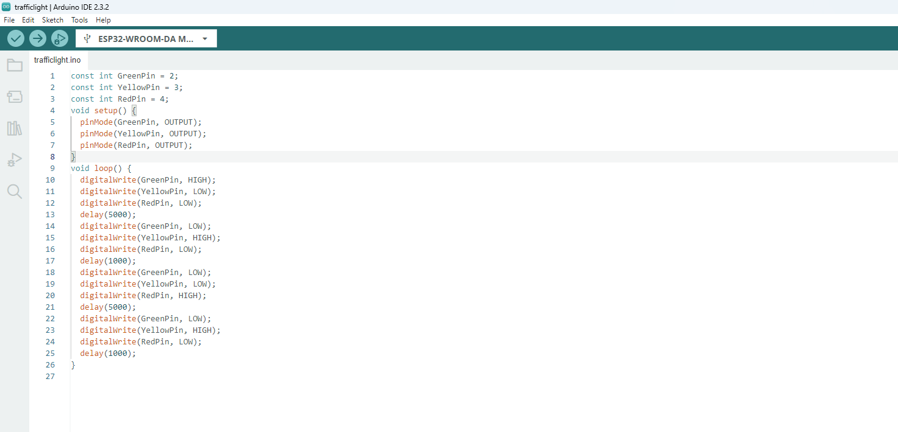
STEP 1
Copy code paste in Arduino new Sketch

Slide 6
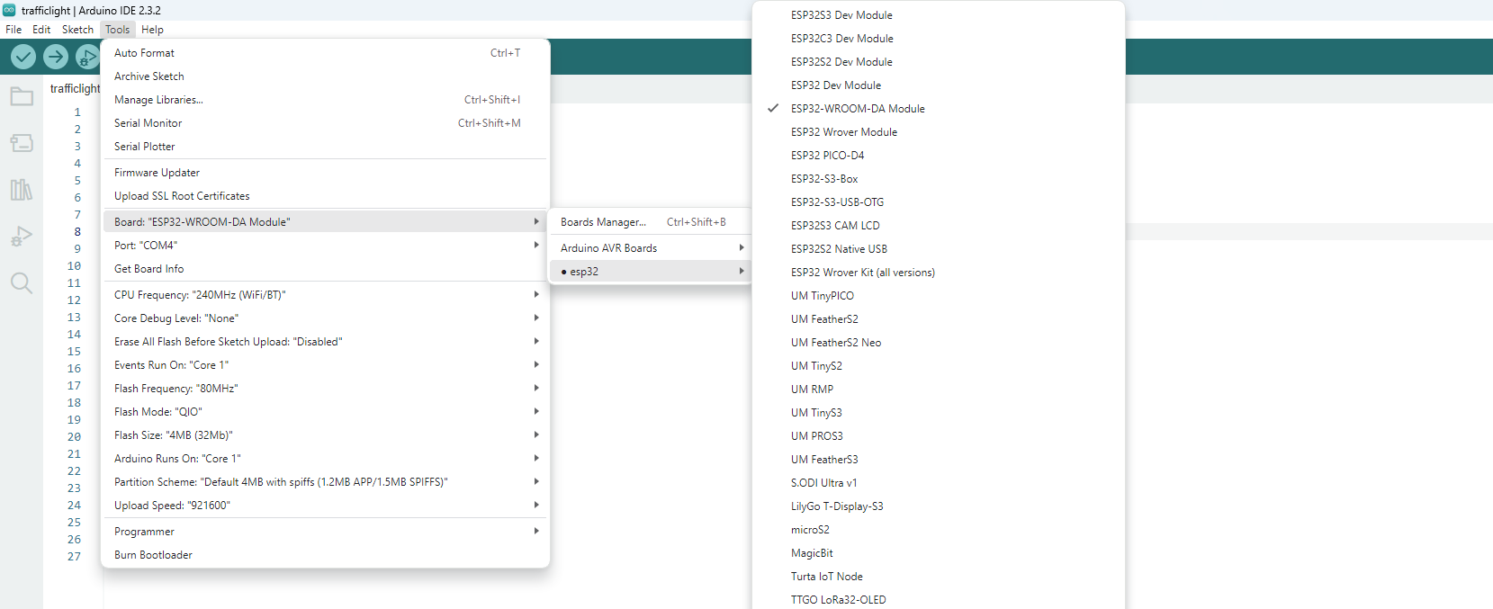
STEP 2:
Board---->esp32---->esp32-wroom-DA module

Slide 7
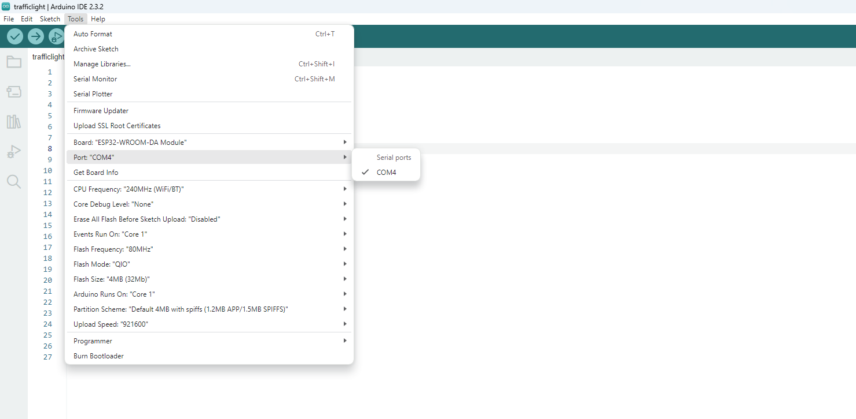
STEP 3:
Tools---->port---->select your com

Slide 8
board name automatically change to dark

Slide 9
Compilation build the code to board
1.Compile the code

Slide 10
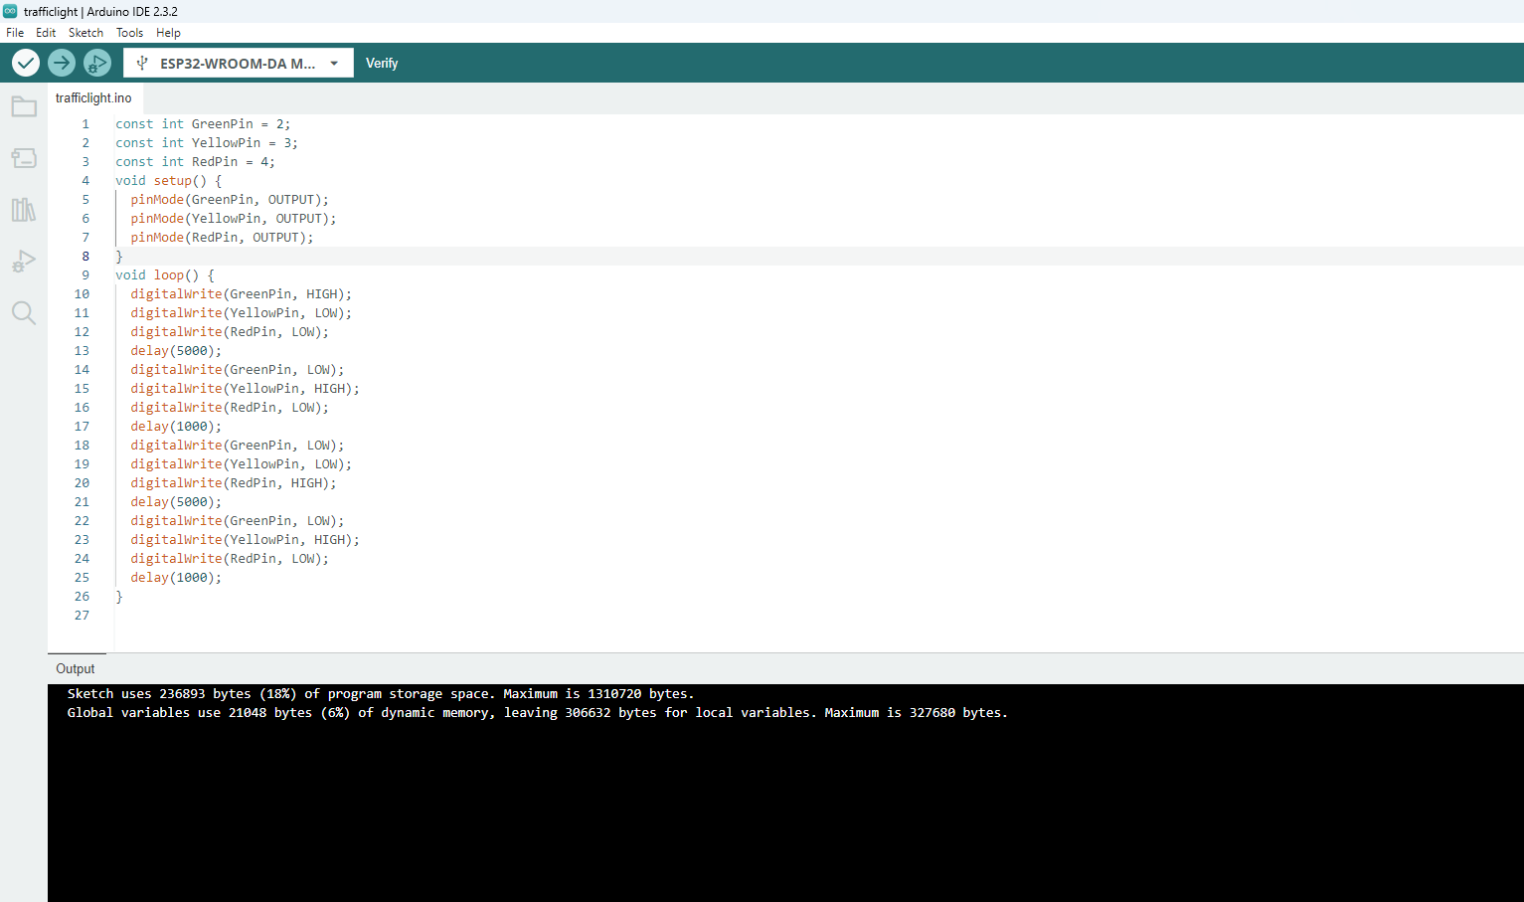
After Build the code the output like this

Slide 11
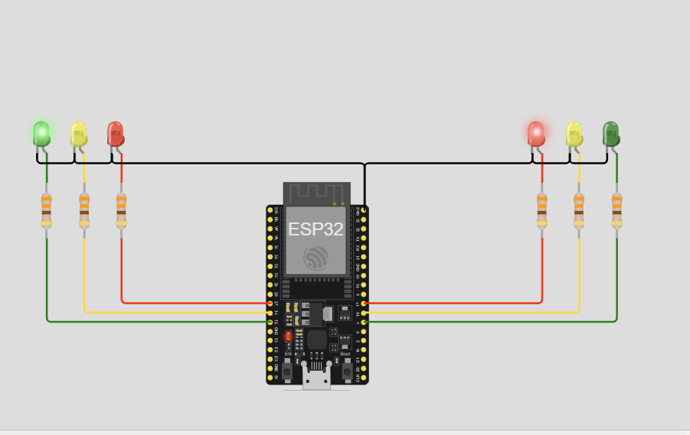
SAMPLE OUTPUT IMAGE FOR TWO WAY TRAFFIC:

